Slide 1
GROUP-4
POSTMAN

Slide 2
INDEX
Introduction
Installation
Need of Postman
Post Request
Get Request
Put Request
Delete Request

Slide 3
INTRODUCTION
Postman is an Application Programming Interface (API) testing tool.
API acts like an interface between a couple of applications and establishes a connection between them.
We require an API whenever we access an application like checking news over the phone, Facebook, and so on.
Postman is a simple Graphic User Interface for sending and viewing HTTP requests and responses.
While using Postman, for testing purposes, one doesn't need to write any HTTP client network code. Instead, we build test suites called collections and let Postman interact with the API.
Postman has the feature of sending and observing the Hypertext Transfer Protocol (HTTP) requests and responses.
It can build multiple HTTP requests − POST, PUT, GET, PATCH and translate them to code.
It has a graphical user interface (GUI) and can be used in platforms like Linux, Windows and Mac.

Slide 4
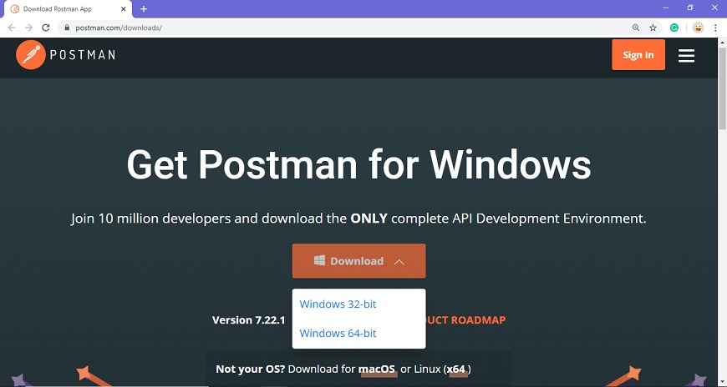
Installation
Go to the link https://www.postman.com/downloads/ and click download for Mac or Windows or Linux based on your operating system.

Slide 5
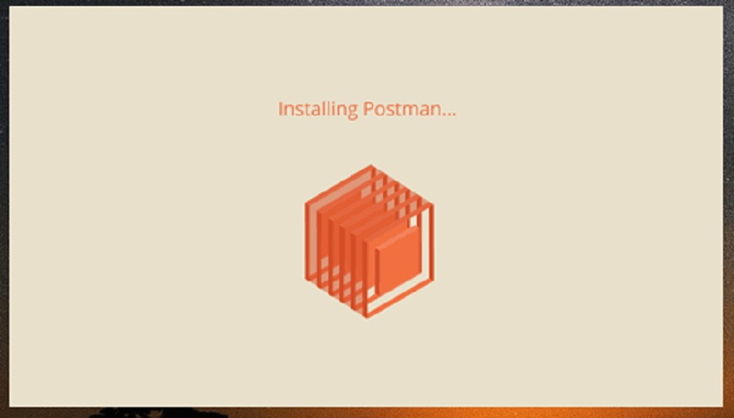
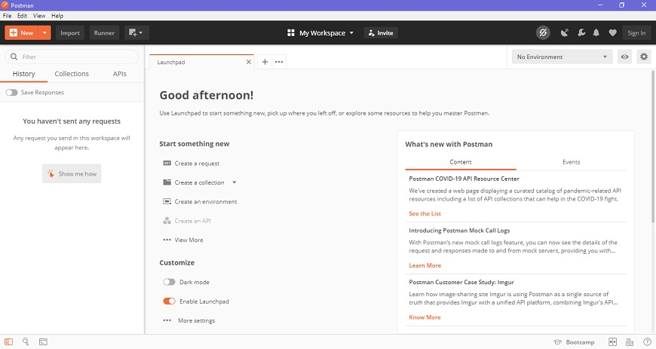
Check the download progress on the bottom left if you are using the Chrome browser. Once the .exe file is downloaded, you need to install the application, as shown in the below image.
Create your account with all the required details and finally you will see the following page, and then you are ready to use Postman.

Slide 6
Need of Postman
Postman can be used for test development by addition of checkpoints to HTTP response codes and other parameters.
Postman can be integrated with the continuous integration and either continuous delivery or continuous deployment (CI/CD) pipeline.
Postman can be integrated with Newman or Collection Runner which allows executing tests in much iteration. Thus we can avoid repeated tests.
Postman has big community support. The Postman console allows debugging test steps.
With Postman, we can create more than one environment. Thus, a single collection can be used with various configurations.
Postman gives the option to import/export Environments and Collections, enabling easy sharing of files.

Slide 7
Post Request
POST request is a method used to add information within the request body in the server.
It is commonly used for passing delicate information.
Once we send some the request body via POST method, the API in turn yields certain information to us in Response. Thus, a POST request is always accompanied with a body in a proper format.
In general, when we submit a POST request, we expect to have some change on the server, such as updating, removing or inserting.
The POST request is a fundamental method, and this method is mostly used when a user wants to send some sensitive data to the server like to send a form or some confidential data.

Slide 8
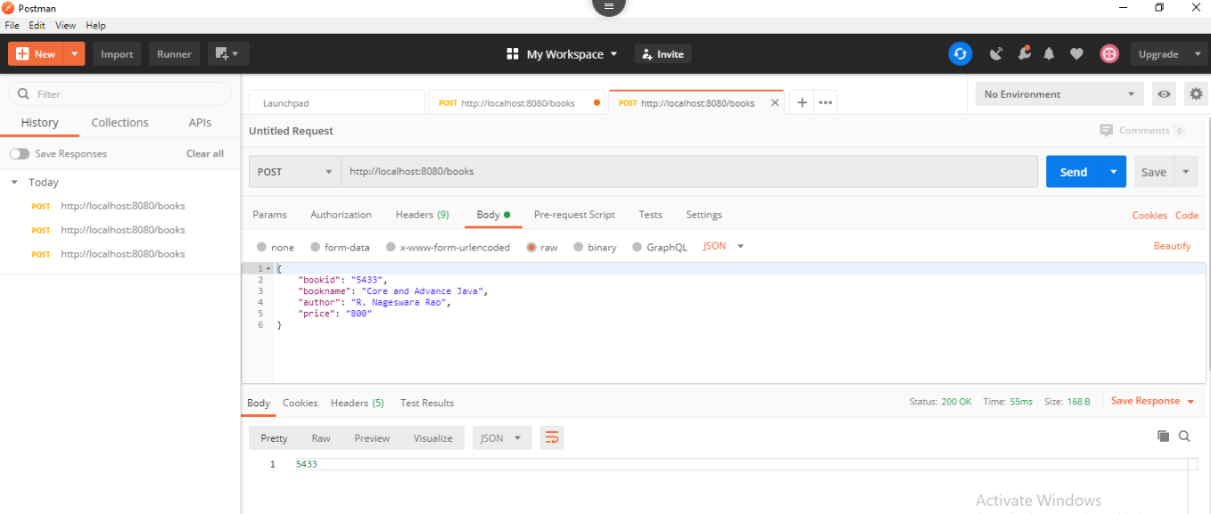
Steps:
Select the POST
Invoke the URL http://localhost:8080/books.
Select the Body
Select he Content-Type JSON (application/json).
Insert the data. We have inserted the following data in the Body:

Slide 9
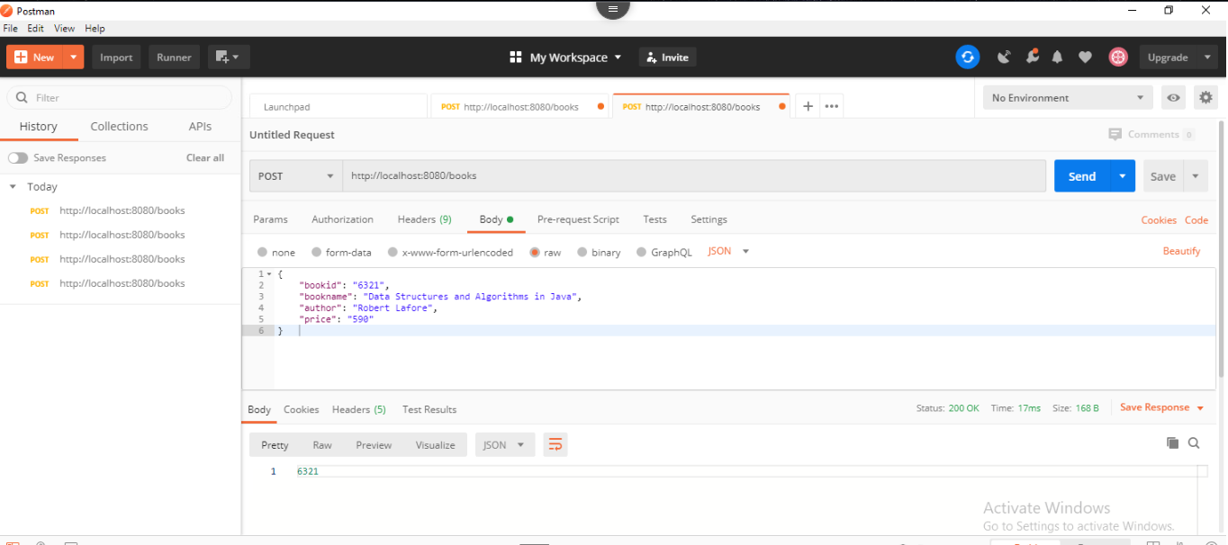
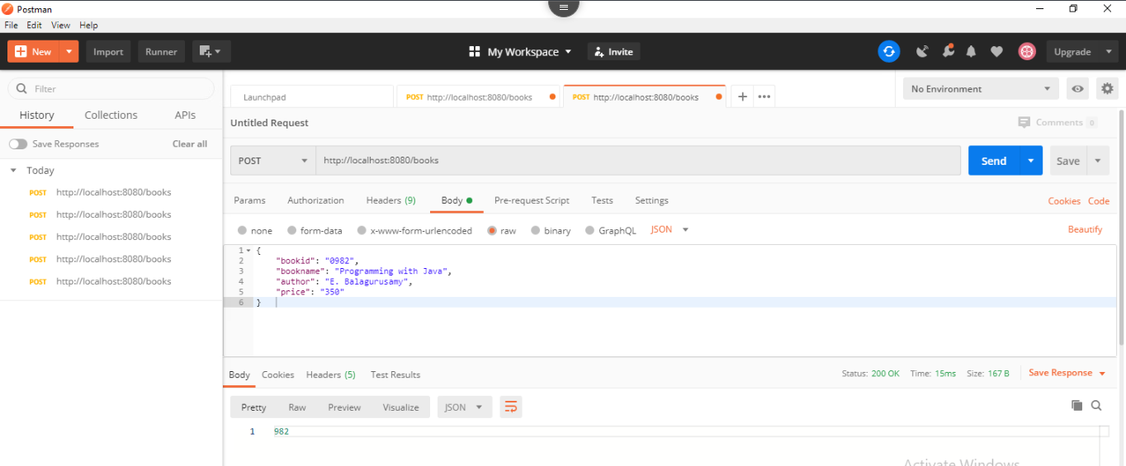
Click on the body and paste the content.

Slide 10
Get Request
GET: This HTTP method is used to access the data from an API.
A GET request is used to obtain details from the server and does not have any impact on the server.
The GET request does not update any server data while it is triggered.
The server only sends its Response to the request.

Slide 11
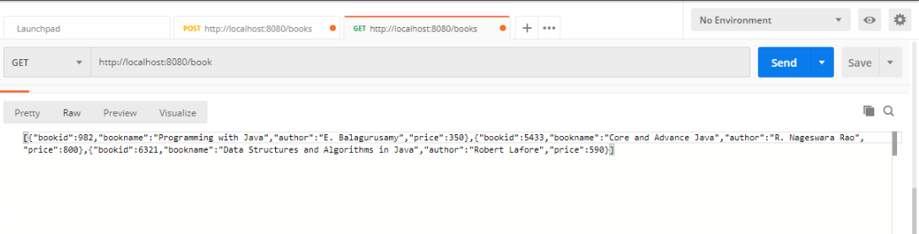
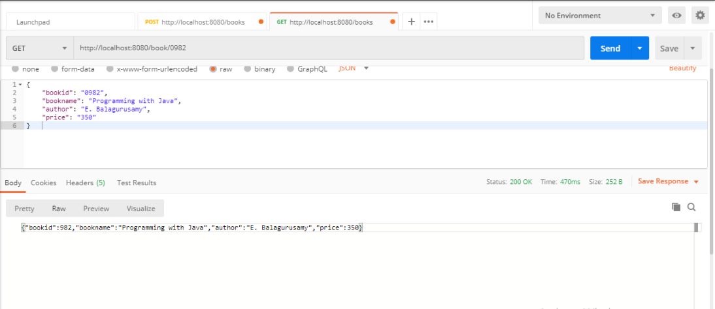
Steps:

Slide 12
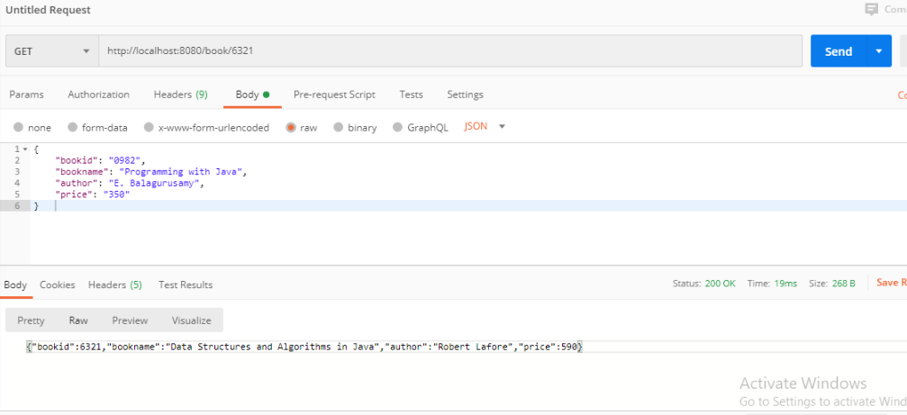
.

Slide 13
Put Request
PUT: This method is used to update the existing data.
PUT request can be used to create a new resource because we need to send a complete payload to the server where the server replaces the existing state of the resource with the latest payload .
It can be used to create a new resource (Depends on API development) if the requested resource is not available.

Slide 14
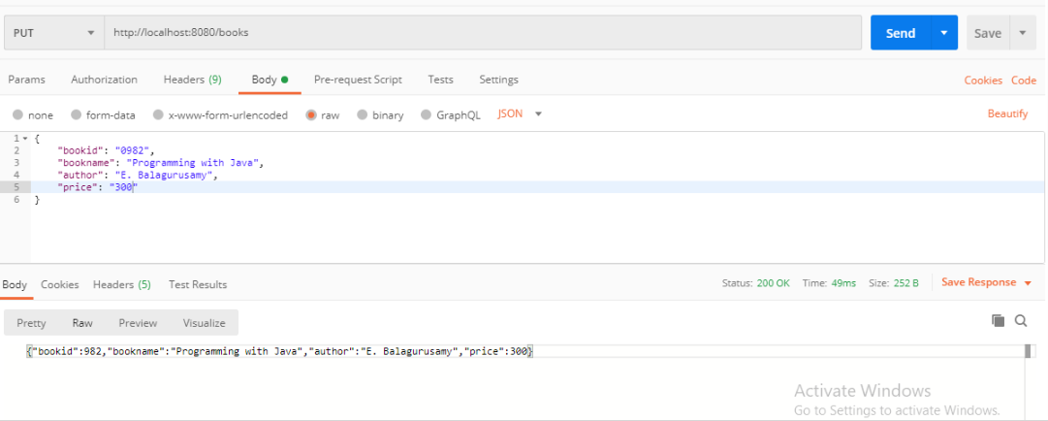
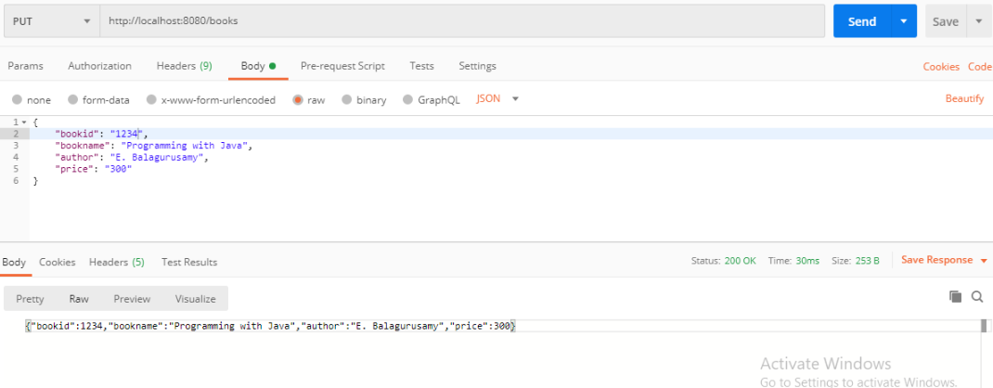
Steps:

Slide 15
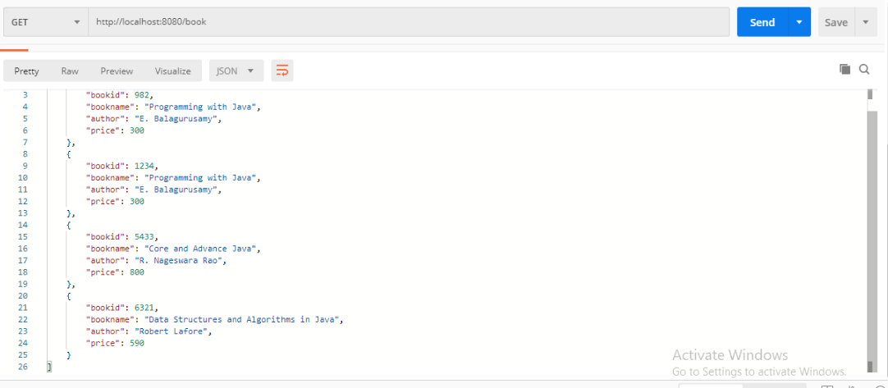
Apply get request to retrieve the current data.

Slide 16
Delete Request
DELETE: This is used to remove or delete the existing data.
DELETE request deletes a resource already present in the server.
The DELETE method sends a request to the server for deleting the request mentioned in the endpoint.
Thus it is capable of updating data on the server.

Slide 17
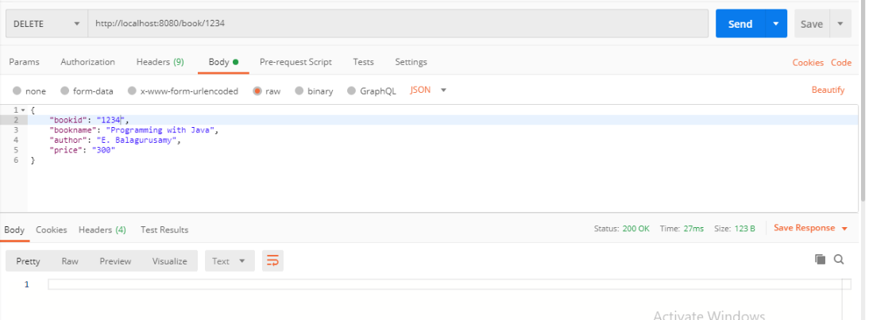
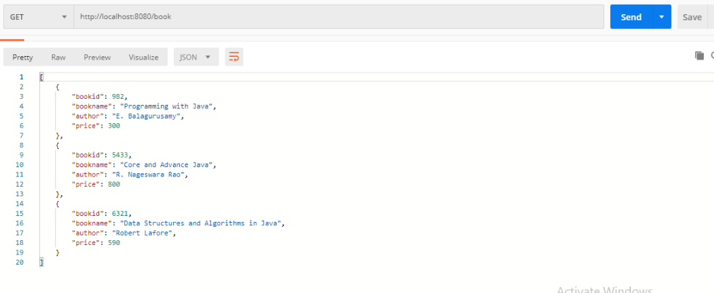
Steps:

